Slide 1
PROJECT TITLE : ADVANCE TRAFFIC NAVIGATION SYSTEM
PIP104 University Project-II
Review-1
Batch Number:
Roll Number | Student Name
20201CEI0144 | PAPPU V S S SUBRAHMANYESWARA REDDY
20201CEI0097 | NAGIREDDY JASWANTH KUMAR REDDY
20201CEI0124 | MITTAPALLI SIVA SAI SANTHOSH
Under the Supervision of,
Ms. Shilpa C N
Assistant Professor
School of Computer Science & Engineering
Presidency University

Slide 2
Introduction
In an era of increasing urbanization and reliance on technology for daily navigation.
The role of digital maps and navigation system has become paramount(supreme).
Google Maps , a ubiquitous platform for travelers has revolutionized the way we plan and execute our journeys. It offers routes, estimated travel times, and more, empowering us to navigate unfamiliar terrain with ease.
The project "Enhancing Google Maps for Safer and Smoother Travel" seeks to build upon this foundation and address some critical challenges that travelers face, particularly in cities like Bangalore.

Slide 3
Literature Review
The foundation of advanced traffic navigation systems lies in the broader context of Intelligent Transportation Systems (ITS).
Researchers (Smith et al., 2017) define ITS as an integrated framework that employs various technologies, including GPS, RFID, communication protocols, sensors, and data analytics, to enable efficient transportation.
This framework serves as the backbone for the development of advanced navigation solutions.
The advent of vehicle-to-infrastructure communication is transforming traditional navigation systems. Dedicated Short Range Communication (DSRC) and Cellular Vehicle-to-Everything (C-V2X).

Slide 4
Literature Review
Smith and Johnson (2018) delve into the intricacies of route optimization algorithms that consider dynamic factors such as traffic conditions, road closures, and user preferences.
protocols facilitate real-time communication between vehicles and infrastructure, enabling enhanced navigation capabilities and improved traffic management (Li et al., 2021).
Furthermore, the integration of machine learning models for predicting traffic patterns and suggesting optimal routes is gaining traction (Chen et al., 2019), opening new avenues for adaptive navigation systems.
powerful simulation tools (Gupta et al., 2020), allowing researchers to study the impact of different navigation strategies on traffic flow.

Slide 5
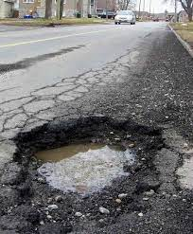
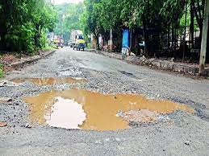
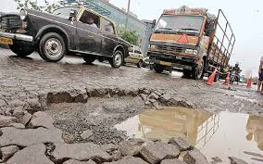
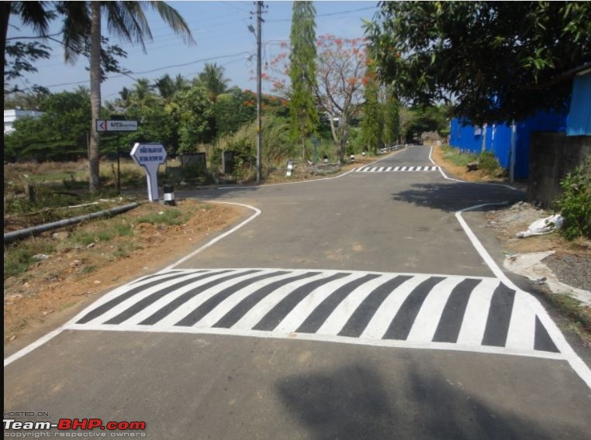
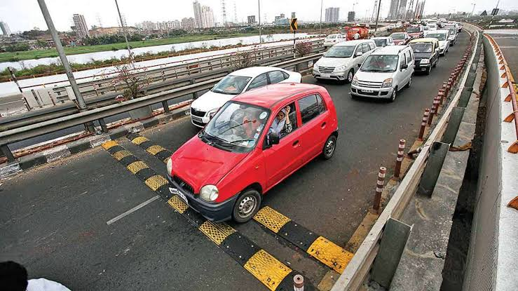
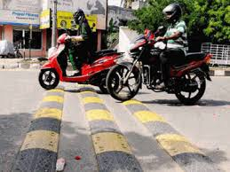
potholes and speed breakers

Slide 6
Implementation details
Implementing a pothole detection system using image processing involves several steps. Below is a simplified example using Python and the OpenCV library. This example assumes that you have a dataset of road images with potholes and non-pothole areas.
import cv2
import numpy as np
Install Required Libraries: Make sure you have Python installed, then install OpenCV using:
- ( pip install opencv-python)
Write the Pothole Detection Code: Create a Python script (e.g., pothole_detection.py) and use the following code as a starting point:
Run the Code: Replace "path/to/your/image.jpg" with the actual path to the image you want to process. Save the script and run it.
(python pothole_detection.py)
Adjust Parameters: You may need to adjust parameters such as the threshold for contour area (area > 100) based on your specific images and requirements.

Slide 7
Algorithm :
# Step 1: Read the image
image = cv2.imread('path/to/your/image.jpg')
# Step 2: Convert the image to grayscale
gray = cv2.cvtColor(image, cv2.COLOR_BGR2GRAY)
# Step 3: Apply GaussianBlur to reduce noise and improve edge detection
blurred = cv2.GaussianBlur(gray, (5, 5), 0)
# Step 4: Apply Canny edge detection
edges = cv2.Canny(blurred, 50, 150)
# Step 5: Find contours in the image
contours, _ = cv2.findContours(edges, cv2.RETR_EXTERNAL, cv2.CHAIN_APPROX_SIMPLE)
# Step 6: Iterate through contours and check for potholes
for contour in contours:
# You can customize the threshold area based on your dataset
if cv2.contourArea(contour) > 500:
x, y, w, h = cv2.boundingRect(contour)
cv2.rectangle(image, (x, y), (x + w, y + h), (0, 255, 0), 2)
# Step 7: Display the result
cv2.imshow('Pothole Detection', image)
cv2.waitKey(0)
cv2.destroyAllWindows()

Slide 8
Psuedocode :
Function detect_potholes(image_path):
# Step 1: Load the image
image = load_image(image_path)
# Step 2: Convert the image to grayscale
gray_image = convert_to_grayscale(image)
# Step 3: Apply GaussianBlur to reduce noise and improve edge detection
blurred_image = apply_gaussian_blur(gray_image)
# Step 4: Apply Canny edge detection
edges = apply_canny_edge_detection(blurred_image)
# Step 5: Find contours in the edged image
contours = find_contours(edges)
# Step 6: Filter contours based on area (size)
min_area = 100 # Adjust this value based on your requirements
filtered_contours = filter_contours(contours, min_area)
# Step 7: Draw rectangles around detected potholes
result_image = draw_rectangles(image, filtered_contours)
# Step 8: Display the result
display_image(result_image)
# Function to load an image
Function load_image(image_path):
# Load the image using a suitable library (e.g., OpenCV)
return loaded_image

Slide 9
Psuedocode :
# Function to convert the image to grayscale
Function convert_to_grayscale(image):
# Convert the image to grayscale using a suitable function (e.g., cv2.cvtColor)
return grayscale_image
# Function to apply GaussianBlur
Function apply_gaussian_blur(image):
# Apply GaussianBlur using a suitable function (e.g., cv2.GaussianBlur)
return blurred_image
# Function to apply Canny edge detection
Function apply_canny_edge_detection(image):
# Apply Canny edge detection using a suitable function (e.g., cv2.Canny)
return edges
# Function to find contours in the image
Function find_contours(image):
# Find contours using a suitable function (e.g., cv2.findContours)
return contours
# Function to filter contours based on area
Function filter_contours(contours, min_area):
# Filter contours based on area using a suitable criterion
return filtered_contours
# Function to draw rectangles around detected potholes
Function draw_rectangles(image, contours):
# Draw rectangles around contours using a suitable function (e.g., cv2.rectangle)
return result_image
# Function to display the image
Function display_image(image):
# Display the image using a suitable function (e.g., cv2.imshow)
wait_for_user_input()
# Function to wait for user input (e.g., a key press)
Function wait_for_user_input():
# Wait for user input to close the displayed image
return

Slide 10
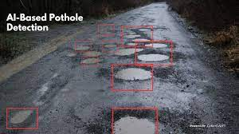
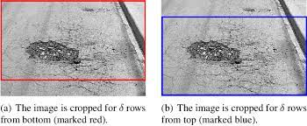
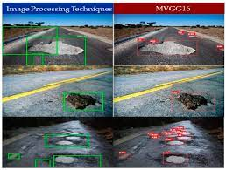
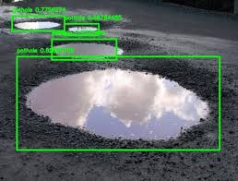
Outcome :

Slide 11
Proposed Method
Data Collection:
Gather real-time data sources, including weather data, traffic data, and user-generated reports.
Integrate APIs or data feeds from weather services, traffic management agencies, and usergenerated reports through a back-end server.
Data Processing and Analysis:
Develop algorithms to process and analyze incoming data.
Use machine learning models to identify patterns in traffic, weather conditions, and road hazards.
Geocode and map real-time data onto Google Maps.
User Engagement:
Create user-friendly interfaces in the Google Maps app for users to access enhanced features.
Encourage users to submit real-time reports on road conditions, including potholes and waterlogged areas.
Real-Time Alerts:
Develop features to provide real-time alerts to users:
Rainwater Accumulation Alerts: Monitor weather conditions and provide warnings or alerts for waterlogged areas.
Pothole and Speed Breaker Warnings: Analyze user-generated reports and sensor data to provide warnings for road conditions.

Slide 12
Proposed Method
Integration with Google Maps:
Utilize the Google Maps API to integrate enhanced features seamlessly.
Display icons, markers, or overlays on the map to indicate real-time road conditions.
Provide options for users to toggle on or off specific alerts and features.
User Education and Public Awareness:
Create educational materials and resources to guide users on using the new features effectively.
Collaborate with local media outlets and transportation authorities to raise public awareness of the enhanced Google Maps features.
Data Privacy and Security:
Ensure data privacy and security measures are in place, including data encryption and compliance with relevant data protection regulations.
Testing and Validation:
Thoroughly test the system for accuracy, usability, and performance.
Collect user feedback during a beta testing phase to identify any issues or improvements needed.
Continuous Monitoring and Maintenance:
Establish a system for continuous monitoring of data sources and user-generated reports.
Regularly update the system to adapt to changing road conditions and user needs

Slide 13
Objectives
Improve Travel Safety:
Provide real-time alerts and warnings to users to enhance their safety during travel.
Reduce accidents and vehicle damage by offering information on road hazards such as potholes and speed breakers.
Enhance Travel Efficiency:
Enable travelers to make informed route decisions based on real-time traffic conditions and weather alerts.
Reduce travel time, fuel consumption, and stress for commuters by offering optimized routes.
User Engagement and Participation:
Encourage user participation by allowing them to submit real-time reports on road conditions.
Foster user engagement through feedback and ratings to continuously improve the system.
Accessible and User-Friendly Features:
Develop intuitive interfaces within Google Maps to make the enhanced features accessible to a wide range of users.
Ensure that users can easily understand and utilize the new features.
Integration with Google Maps:
Utilize the Google Maps API to integrate enhanced features seamlessly.
Display icons, markers, or overlays on the map to indicate real-time road conditions.
Provide options for users to toggle on or off specific alerts and features.

Slide 14
Methodology
Improve Travel Safety:
Provide real-time alerts and warnings to users to enhance their safety during travel.
Reduce accidents and vehicle damage by offering information on road hazards such as potholes and speed breakers.
Enhance Travel Efficiency:
Enable travelers to make informed route decisions based on real-time traffic conditions and weather alerts.
Reduce travel time, fuel consumption, and stress for commuters by offering optimized routes.
User Engagement and Participation:
Encourage user participation by allowing them to submit real-time reports on road conditions.
Foster user engagement through feedback and ratings to continuously improve the system.
Accessible and User-Friendly Features:
Develop intuitive interfaces within Google Maps to make the enhanced features accessible to a wide range of users.
Ensure that users can easily understand and utilize the new features.
Public Awareness and Education:
Educate travelers about the availability and benefits of the enhanced features through public awareness campaigns.
Empower users with the knowledge of how to effectively use these features for safer and more efficient travel.

Slide 15
Timeline of Project
1.Title Finalization with Supervisor | Review-0 | 11-10-2023
2.Methods & Software Details | Review-1 | 08-11-2023
3.Algorithm Details | Review-2 | 28-11-2023
4.50 % implementation details | Review-3 | 27-12-2023
5.Demonstration | Review-4 | 10-01-2024

Slide 16
Expected Outcomes
Safer Travel : Users will experience safer journeys by receiving real-time alerts and warnings about road hazards, rainwater accumulation, potholes, and speed breakers. This will reduce the risk of accidents and damage to vehicles.
Efficient Travel : Travelers will benefit from more efficient route planning, leading to reduced travel times and lower fuel consumption. Optimized routes and traffic updates will contribute to smoother commutes.
User Engagement : The project will foster user engagement and participation, as users submit real-time reports and provide feedback on road conditions. This engagement will contribute to the system's continuous improvement.
User-Friendly Interface: The enhanced Google Maps features will be seamlessly integrated into the user interface, making them accessible and user-friendly for a broad range of travelers.
Public Awareness and Education: Travelers will become more aware of the availability and benefits of the enhanced features through public awareness campaigns. Educational materials will empower users to use the system effectively.

Slide 17
Conclusion
The project, "Enhancing Google Maps for Safer and Smoother Travel”, holds great promise for revolutionizing the way people navigate and experience their journeys.
By integrating real-time data on road conditions, weather hazards, and user-generated reports, this project aims to create a more informed, efficient, and secure travel experience.
The potential for this project to make a positive impact on daily commutes is substantial, With the integration of advanced features into Google Maps.
Additionally, user engagement and collaboration with public authorities and agencies can further enhance the system's effectiveness over time.

Slide 18
References
Open StreetMap : https://www.openstreetmap.org/#map=4/21.84/82.79
Advance in transportation:
https://www.atsinternationaljournal.com/
Road Traffic Modeling and Management(book) :
authors : Fouzi harrou,abdelhafid Zeroual
ResearchGate :
https://www.researchgate.net/
Intelligent transportation system :
https://en.wikipedia.org/wiki/Intelligent_transportation_system

Slide 19
Thank You

